Slide 1
Intro
to
Flexibowl®
Solutions
and
Applications
ars Industrial Robotics and X-Ray

Slide 2
Contents
FlexiBowl® and Options
Bulk Feeders and Motorised Hoppers
FlexiVision
Market Information and Reference
Market Benchmarking
Our Services

Slide 3
FlexiBowl®: How it works
0
Motorised Hopper - Large parts storage capacity
Vibrating Bulk Feeder - Drops parts accurately
Wiper - Diverts parts from outer wall, back under picking area
Servo Driver - ethernet/UDP or digital I/O communication
Direct Drive Motor
Flip unit - turns and spreads parts
6
Blow Unit, Diverts tiniest parts from outer wall
Quick-change disc, Different colours, textures and coatings
Backlight, Red, White and Infrared colours
Toplight, Red, White and Infrared colours
FlexiVision, fully integrated vision system
1
7
2
8
3
9
4
10
5
Vision system controls FlexiBowl® movements, parts flow from the bulk feeder and sends coordinates to the robot
Parts are sorted by combined actuation of servomotor and flip unit
Acceleration, speed, flipping frequency and power parameters are set according to part geometry, material and dimension
ars Industrial Robotics and X-Ray

Slide 4
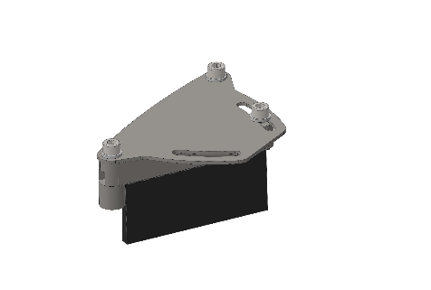
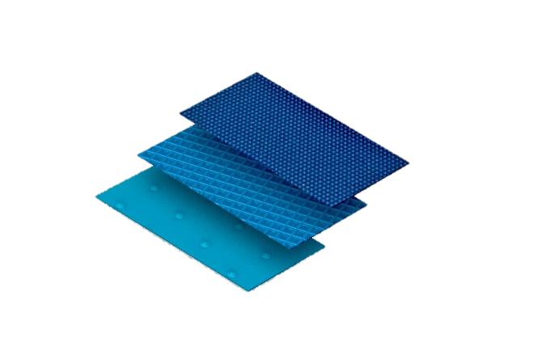
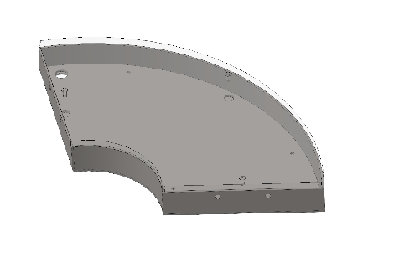
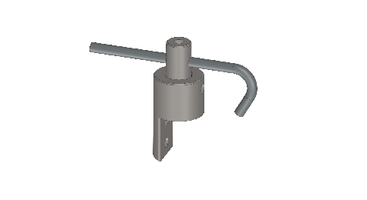
Options: How they work
Click on the picture to open the video
Wiper
Blow Unit
Backlight/ Toplight
Rotary Disc
ars Industrial Robotics and X-Ray

Slide 5
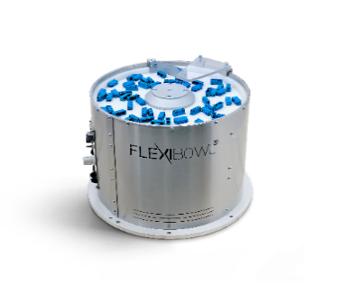
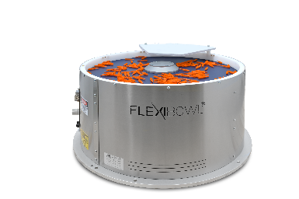
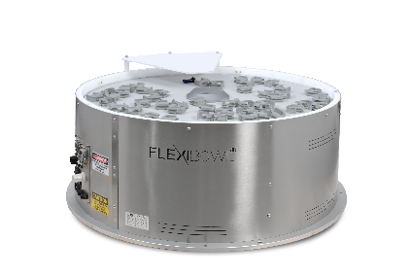
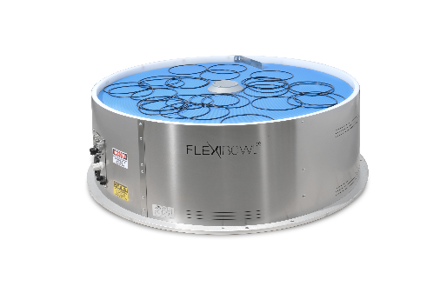
FlexiBowl®: How to choose
FlexiBowl® 350
FlexiBowl® 500
FlexiBowl® 650
FlexiBowl® 800
Recommended part size
1>x<15mm
5>x<50mm
20>x<110mm
60>x<250mm
Maximum part weight
<40gr
<100gr
<170gr
<250gr
Bulk storage capacity
5/10dm3
10/20dm3
20/40dm3
20/40dm3
Maximum pick widow
125/220mm
205/360mm
390/250mm
390/315mm
Pick widow (area)
177cm2
475cm2
900cm2
1183cm2
Permissible load
3kg
5kg
5kg
5kg
Pick level above surface
240mm
240mm
270mm
270mm
Feeder weight
25kg
36kg
51kg
71kg
ars Industrial Robotics and X-Ray

Slide 6
Contents
FlexiBowl® and Options
Bulk Feeders and Motorised Hoppers
FlexiVision
Market Information and References
Market References
Our Services

Slide 7
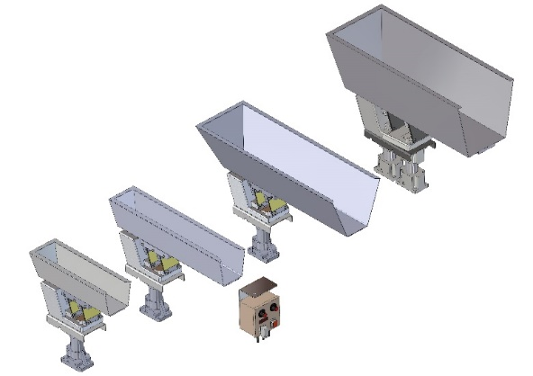
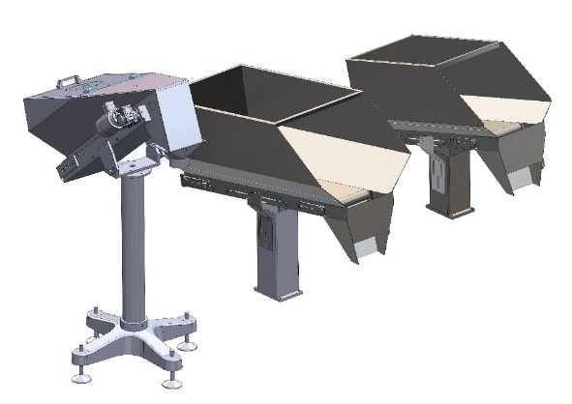
Options: Bulk storage
Vibrating bulk feeders
Combine them to get parts flow control with higher storage capacity
Motorized hoppers
Accurate and continuous parts flow
Large amount of parts can be stored
5, 10, 20 & 40 liters available for parts storage
Polyurethane coating is available as an option to reduce loud noise when handling metal components
Up to 300 liters avialble for parts storage
The hoppers are custom made and samples may be nedeed to define the set up
ars Industrial Robotics and X-Ray

Slide 8
Contents
FlexiBowl® and Options
Bulk Feeders and Motorised Hoppers
FlexiVision
Market Information and References
Market Benchmarking
Our Services

Slide 9
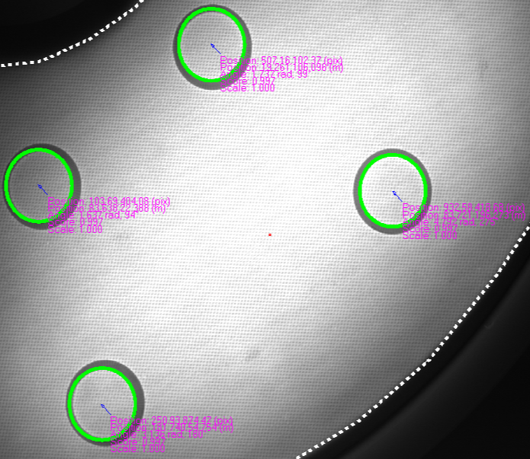
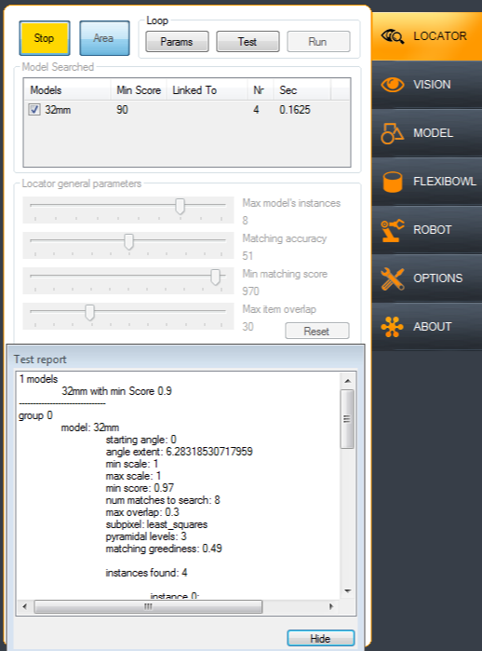
FlexiVision: Vision system
FlexiVision user friendly interface
FlexiVision is an integrated PC-based vision software for robot guidance, developed on HALCON libraries.
It is designed for fast setup and deployment of FlexiBowl® applications.
Control FlexiBowl® parameters
Calibrate the camera and the robot
Design and manage your recipes
Geometry and pattern matching
Hundreds of industrial GigE cameras supported
Connect up to 3 cameras and 2 robot with a single dongle key

Slide 10
Robot Integrated Worldwide

Slide 11
Contents
FlexiBowl® and Options
Bulk Feeders and Motorised Hoppers
FlexiVision
Market Information and References
Market Benchmarking
Our Services

Slide 12
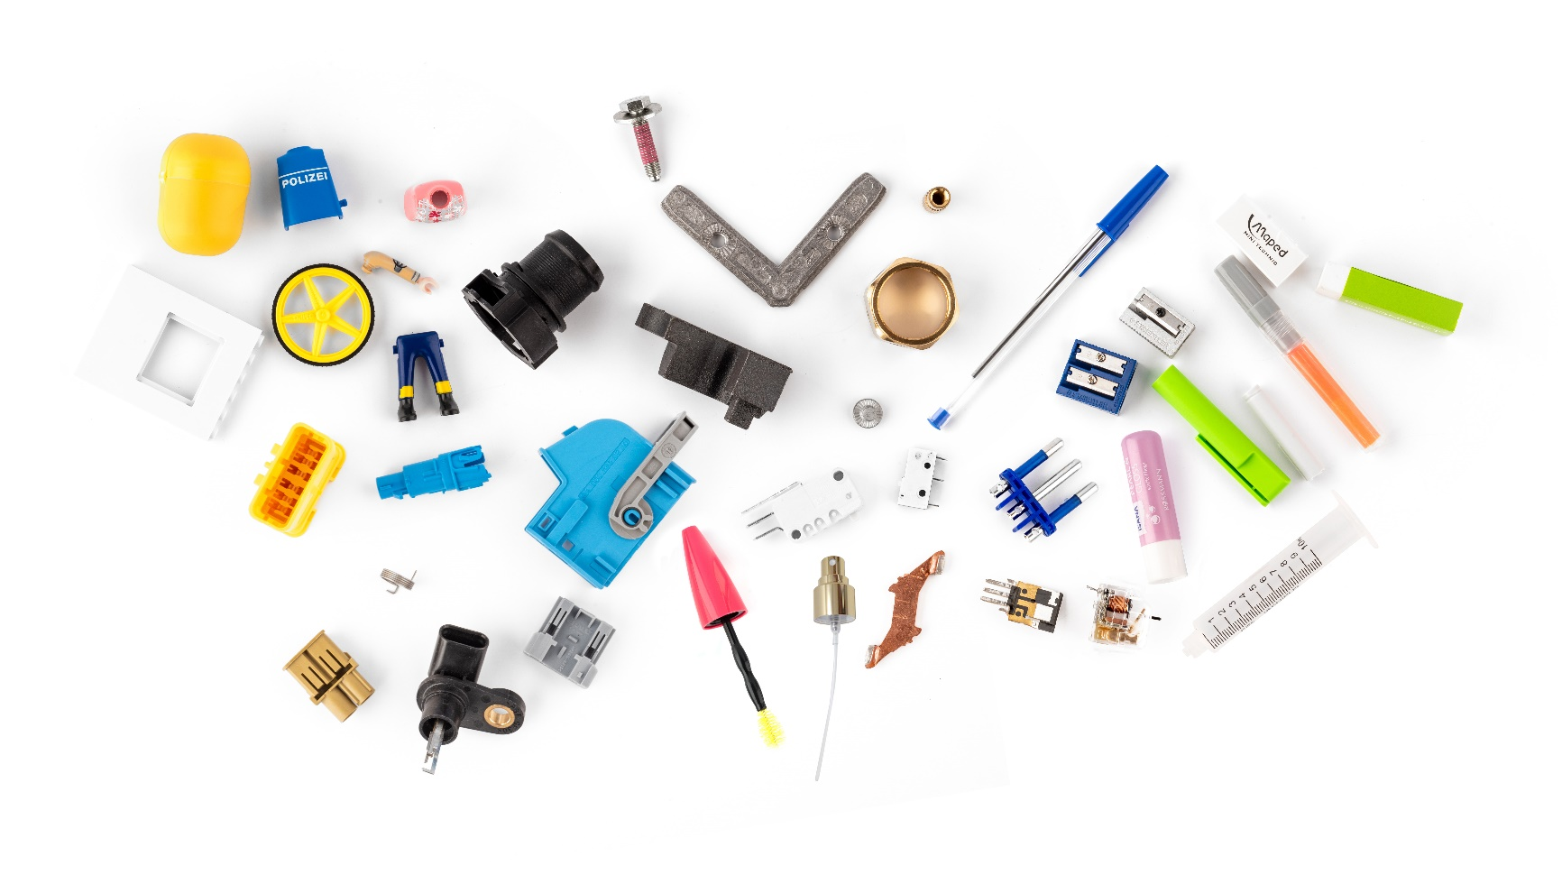
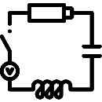
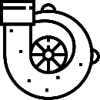
Typical Applications
MACHINE TENDING
CNC, welding, pad printing laser
marking, plastic moulding..
FASHION ACCESSORIES
and PRECISION PARTS
Buckle, eyewear, knob, hinge..
TOYS and GADGETS
Assembly, kits, pad printing
painting, packing..
CONSUMER
ELECTRONICS
Laptop, smartphone..
MEDICAL DISPOSABLES
Stopcock, drip chamber,
syringe, needle, filter..
HOUSE AND
PRSONAL CARE
Dispenser, spray pump,
toothbrush..
COSMETICS
Lipstick, lids, brushes,
bottle, tube, cup..
HOUSE APPLIANCES
PARTS
Oven, washing machine..
ELECTRICAL PARTS
Relay, connector, diode,
switch, coil..
AUTOMOTIVE PARTS
Mechanism, connection,
transmission,
fluid management..
ars Industrial Robotics and X-Ray

Slide 13
Worldwide References: End Users
ars Industrial Robotics and X-Ray

Slide 14
Contents
FlexiBowl® and Options
Bulk Feeders and Motorised Hoppers
FlexiVision
Market Information and References
Market Benchmarking
Our Services

Slide 15
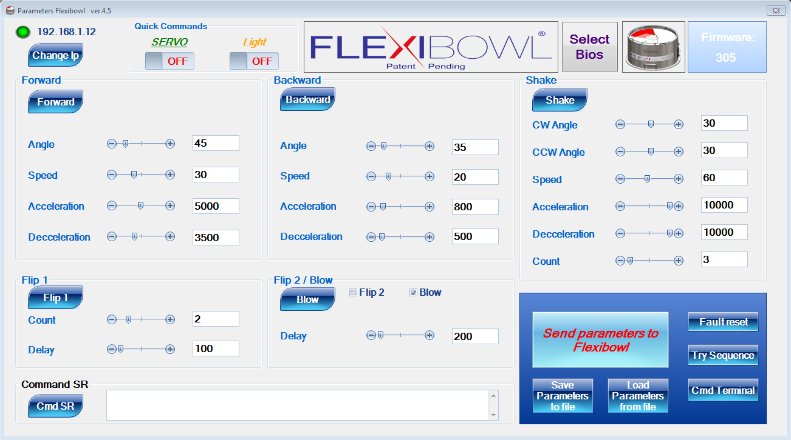
FlexiBowl®: Parameters
Easy to set up
ars Industrial Robotics and X-Ray

Slide 16
Contents
FlexiBowl® and Options
Bulk Feeders and Motorised Hoppers
FlexiVision
Market Information and References
Market Benchmarking
Our Services

Slide 17
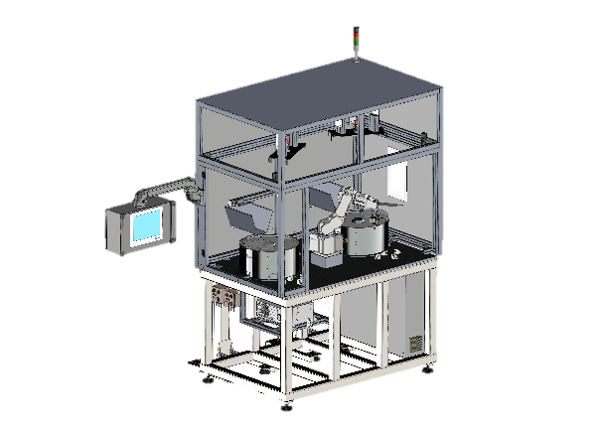
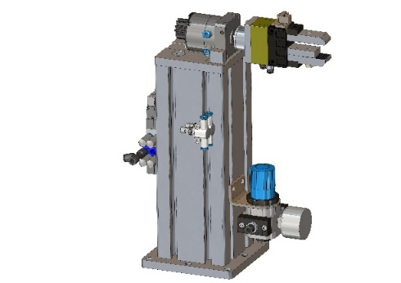
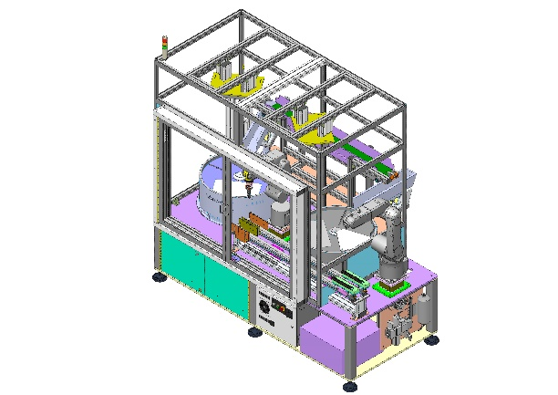
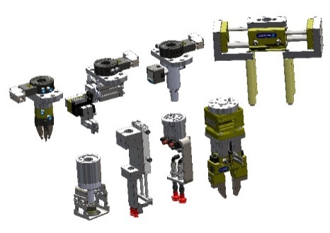
ARS leads all the way through
Tech advisory
& support
Preliminary analysis
Viability tests
Feed rate optimization
Equipments
design
Training
System
ramp up
After-sale service
Remote
support
ars Industrial Robotics and X-Ray

Slide 18
THANK YOU
Via Piero Gobetti, 19 | 52100 Arezzo (IT) Italy
Tel. +39 0575 398612 | Fax +39 0575 398620 | info@arsautomation.com
www.arsautomation.com | www.flexibowl.com
ARS Automation

